Slide 1
Referendum Renewal Background
April 6, 2026

Slide 4
5 Year Budget Forecasts
5 Year Forecast With Levy Renewal in FY 29
5 Year Forecast with No Levy in FY 29

Slide 5
Board Renewal of Referendums
Legislative change in 2023 allows a school board
to renew existing operating referendums
One time at same length and amount as original
request
Includes inflationary increases if in existing
authority
School Board must allow for public testimony on
the proposed renewal prior to taking action

Slide 6
Statewide Operating Referendum
FY 2027
329 public school districts
  73% with voter approved referendum
  27% without voter approved referendum
State Median Referendum = $635
Metro Median Referendum = $1,893
  Only 4 districts out of 57 in seven county metro do
  not have an operating referendum

Slide 7
Board Renewal of Referendums
ISD 77 referendum expires after taxes payable
in 2027 (FY 2028)
Board can renew referendum anytime between
July 1, 2025 and June 15, 2027
New 10 years of renewed referendum begins
FY 2029 through FY 2038

Slide 8
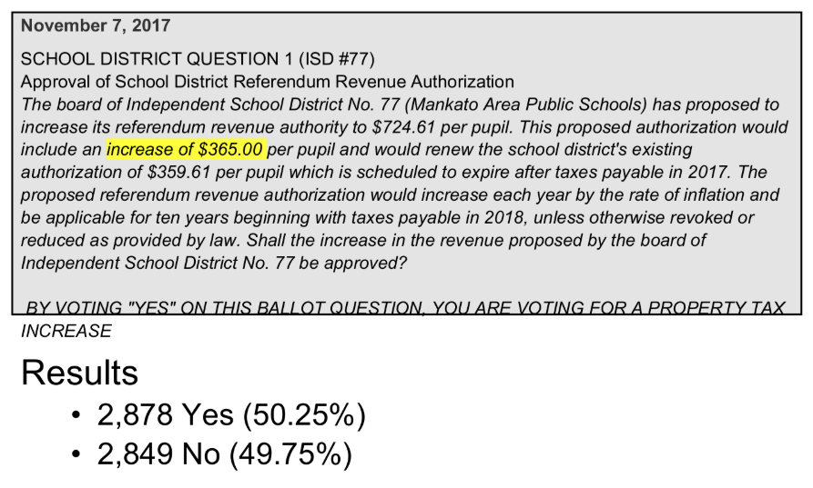
2017 Operating Referendum Authority

Slide 9
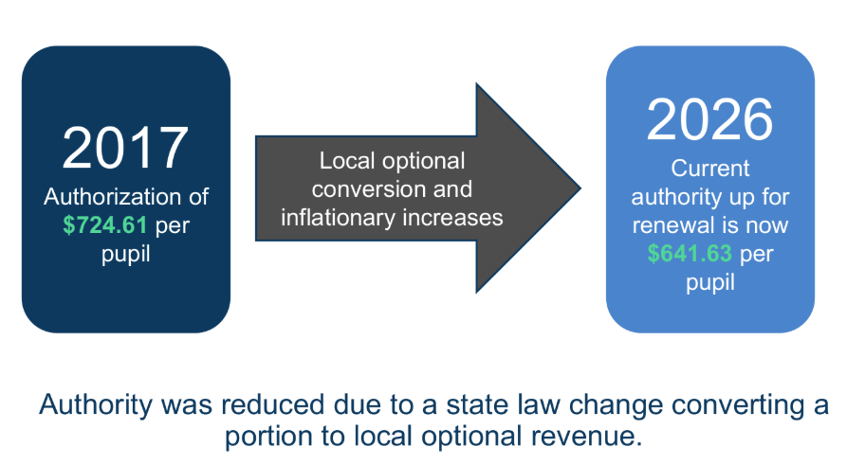
State Law Changes to Operating Referendum

Slide 10
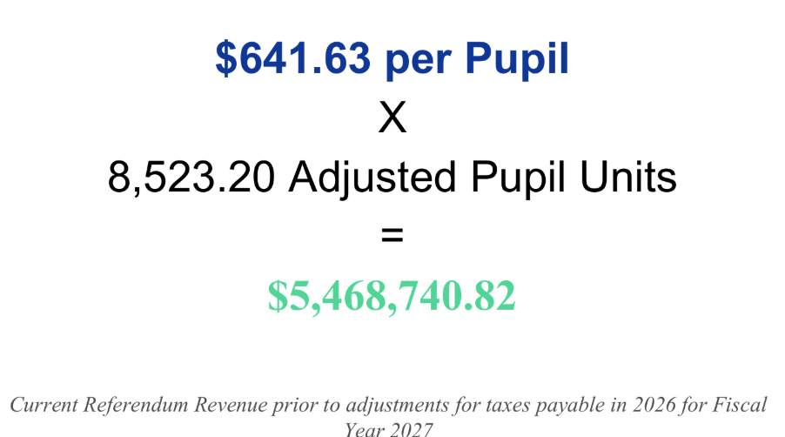
Current Operating Referendum (Pay 2026 / FY 2027)

Slide 11
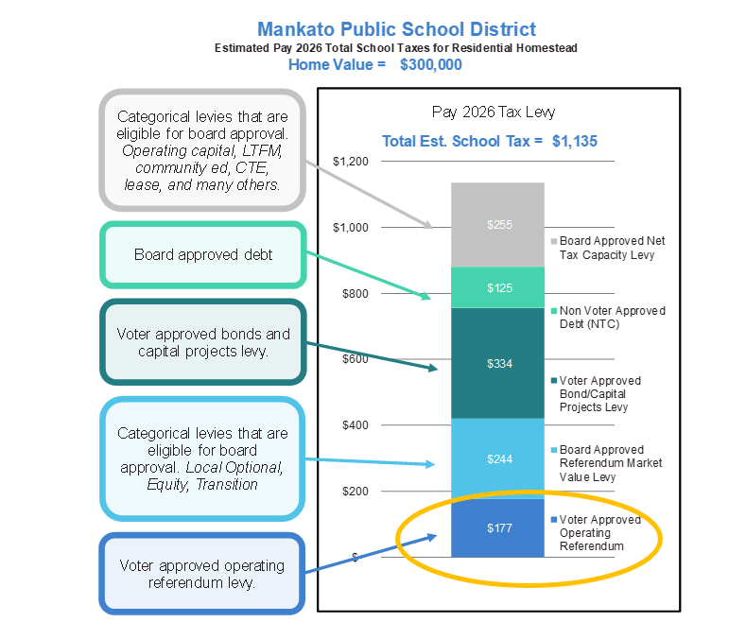
Current Total School Taxes

Slide 12
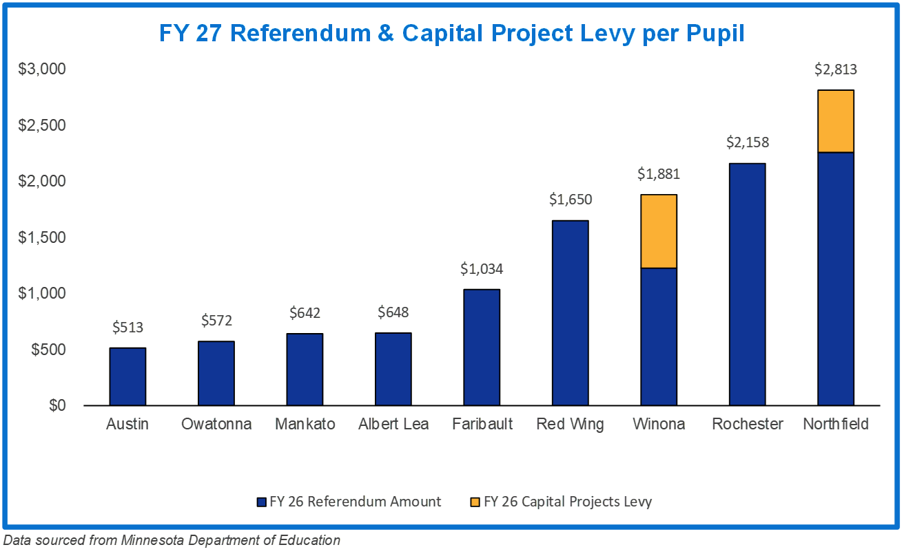
Operating Referendum & Capital Projects Levy
Comparison FY 2027

Slide 13
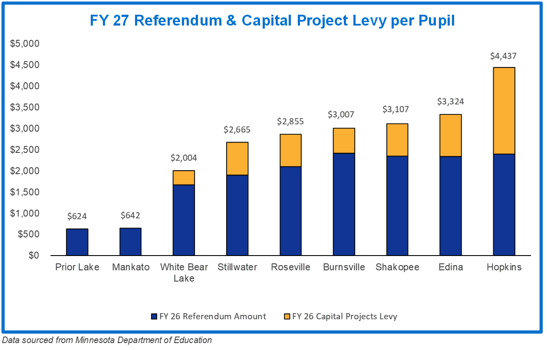
Operating Referendum & Capital Projects Levy
Comparison FY 2027

Slide 14
Other Factors for Consideration
Avoids election expenses
Near unanimous support of referendum
renewals across the state in the years leading
up to law change
Renewal authority has been widely used since
it was granted by legislature

